Slide 1
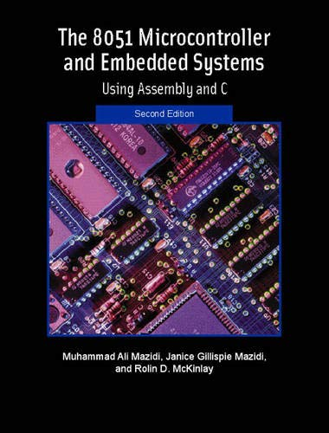
THE 8051
MICROCONTROLLER & Embedded Systems
Muhammad Ali Mazidi, Janice Mazidi
& Rolin McKinlay

Slide 2
ADC, DAC,
AND SENSOR
INTERFACING
Chapter 13

Slide 3
Objectives
Upon completion of this chapter, you will be able to:
>> Interface ADC (analog-to-digital converter) chips to the 8051
>> Interface temperature sensors to the 8051
>> Explain the process of data acquisition using ADC chips
>> Describe factors to consider in selecting an ADC chip
>> Describe the function of the pins of 804/809/848 ADC chips
>> Describe the function of the pins of the MAX1112 serial ADC chip
>> Interface serial ADC chips to the 8051
>> Program serial and parallel ADC chips in 8051 C and Assembly
>> Describe the basic operation of a DAC (digital-to-analog converter) chip
>> Interface a DAC chip to the 8051
>> Program a DAC chip to produce a sine wave on an oscilloscope
>> Program DAC chips in 8051 C and Assembly
>> Explain the function of precision IC temperature sensors
>> Describe signal conditioning and its role in data acquisition

Slide 4
Objectives
More real-world devices such as ADCs (analog-to-digital converters), DACs (digital-to-analog converters), and sensors, and how to interface the 8051 to these devices,
Section 13.1, analog-to-digital converter (ADC) chips, the 8-bit parallel ADC chips ADC0804, ADC0808/0809, and ADC0848 We will also look at the serial ADC chip MAX1112,
Section 13.2, the characteristics of DAC chips
Section 13.3, the interfacing of sensors and discuss the issue of signal conditioning

Slide 5
Table 13-1: Resolution vs. Step Size for ADC
n-bit Number of steps Step Size (mV)
8 256 5/256 = 19.53
10 1024 5/1024 = 4.88
12 4096 5/4096 = 1.2
16 65536 5/65536 = 0.076
Notes: V_{CC} = 5 V
Step size (resolution) is the smallest change that can be discerned by an ADC.

Slide 6
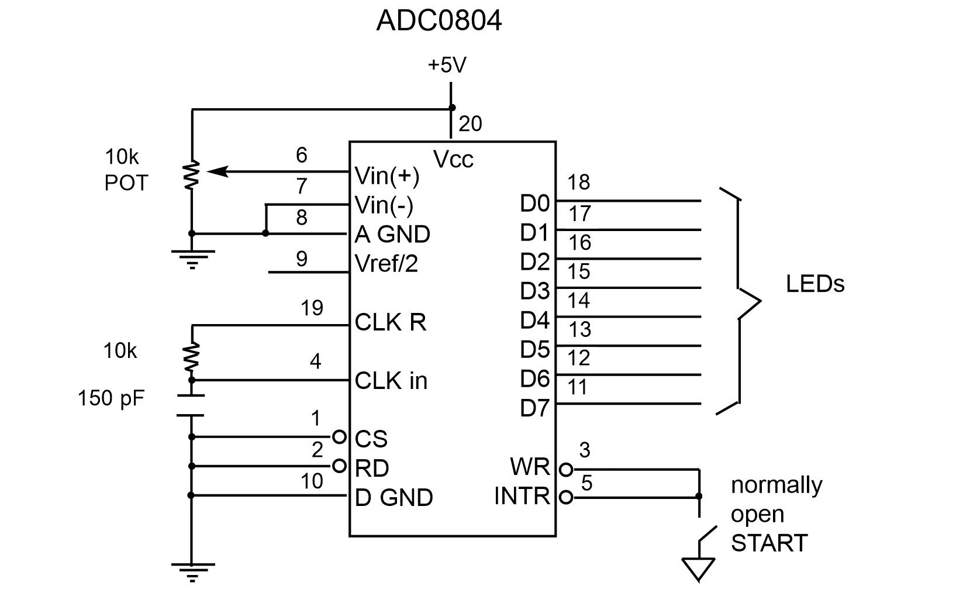
Figure 13-1. ADC0804 Chip (testing ADC0804 in free running mode)

Slide 7
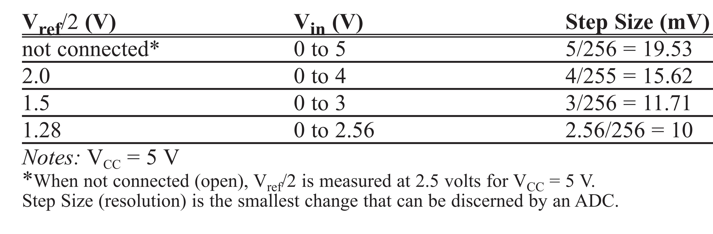
Table 13-2: V_{ref}/2 Relation to V_{in} Range (ADC0804)

Slide 8
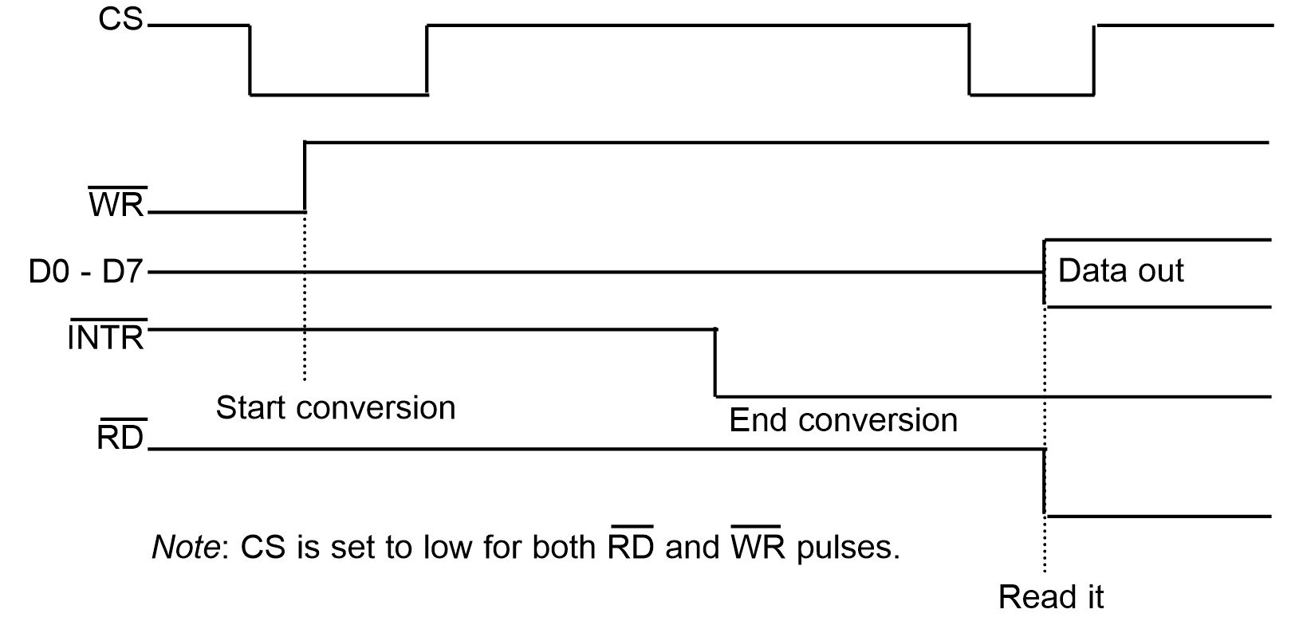
Figure 13-2. Read and Write Timing for ADC0804

Slide 9
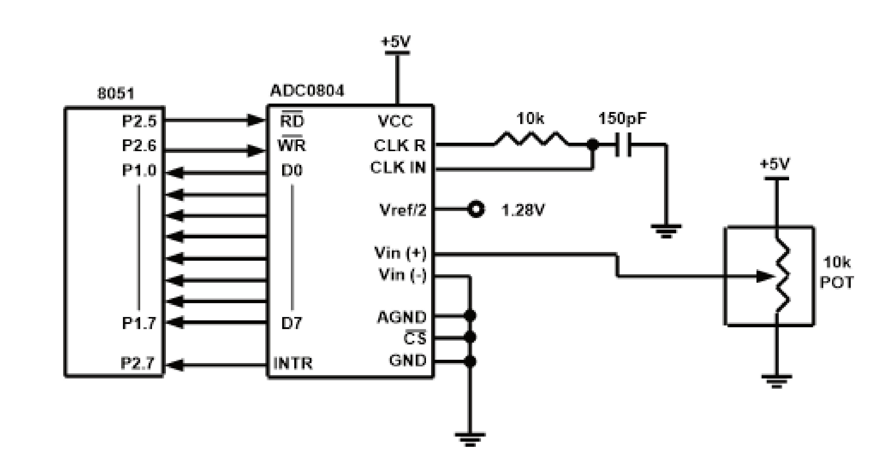
Figure 13-3. 8051 Connection to ADC0804 with Self-Clocking

Slide 10
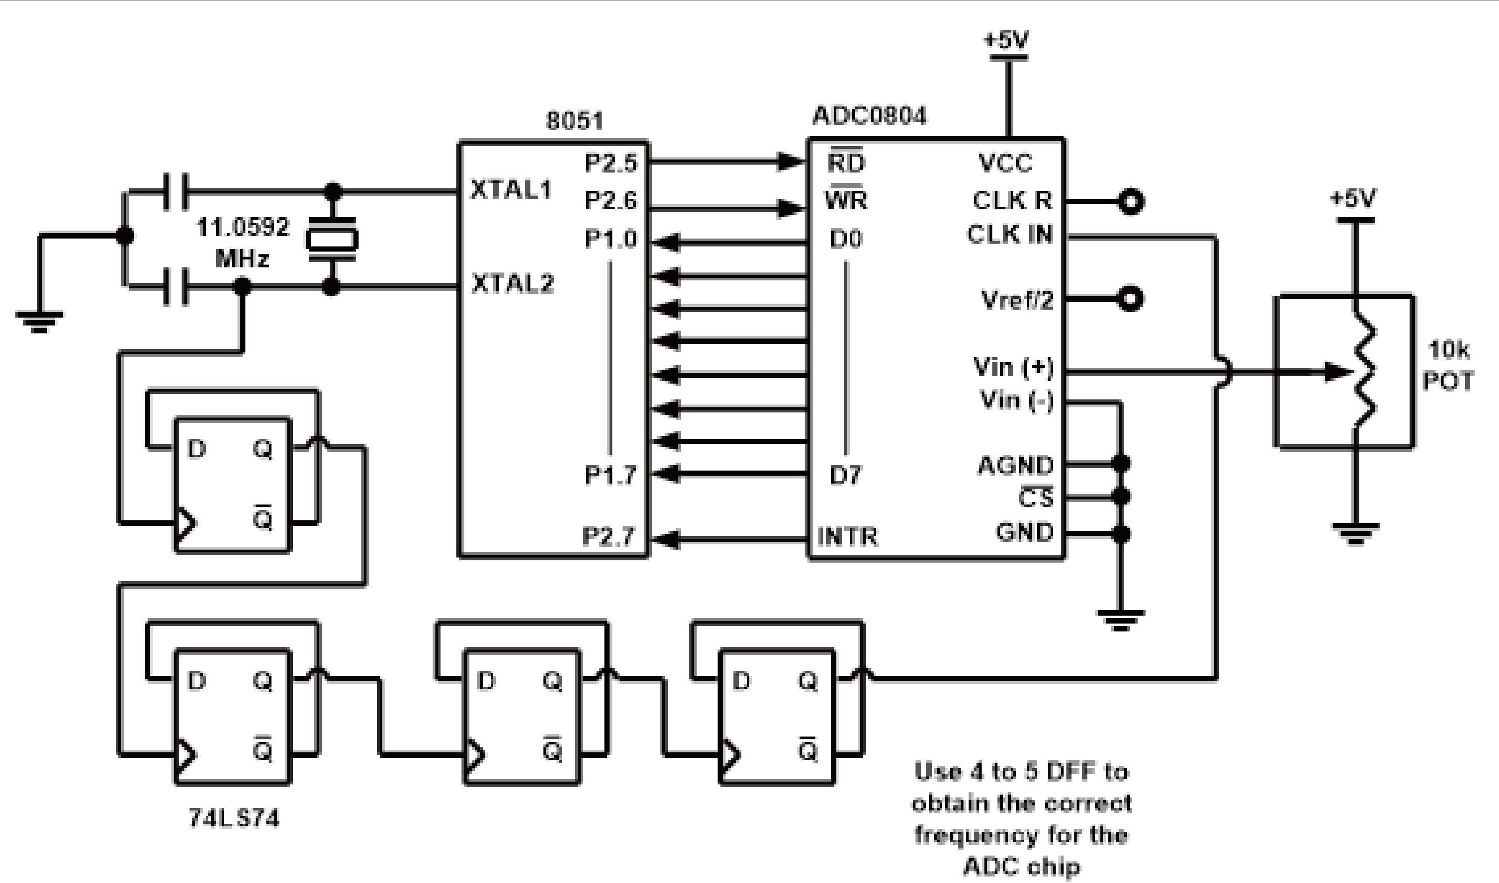
Figure 13-4. 8051 Connection to ADC0804 with Clock from XTAL2 of the 8051

Slide 11
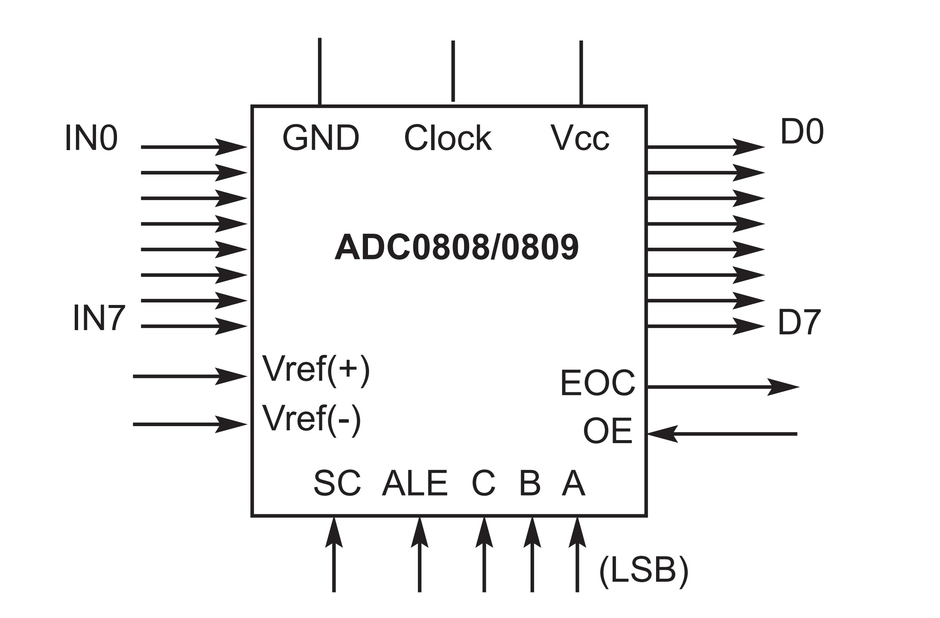
Figure 13-5. ADC0808/0809

Slide 12
Table 13-3: ADC0808/0809 Analog Channel Selection
Selected Analog Channel C B A
IN0 0 0 0
IN1 0 0 1
IN2 0 1 0
IN3 0 1 1
IN4 1 0 0
IN5 1 0 1
IN6 1 1 0

Slide 13
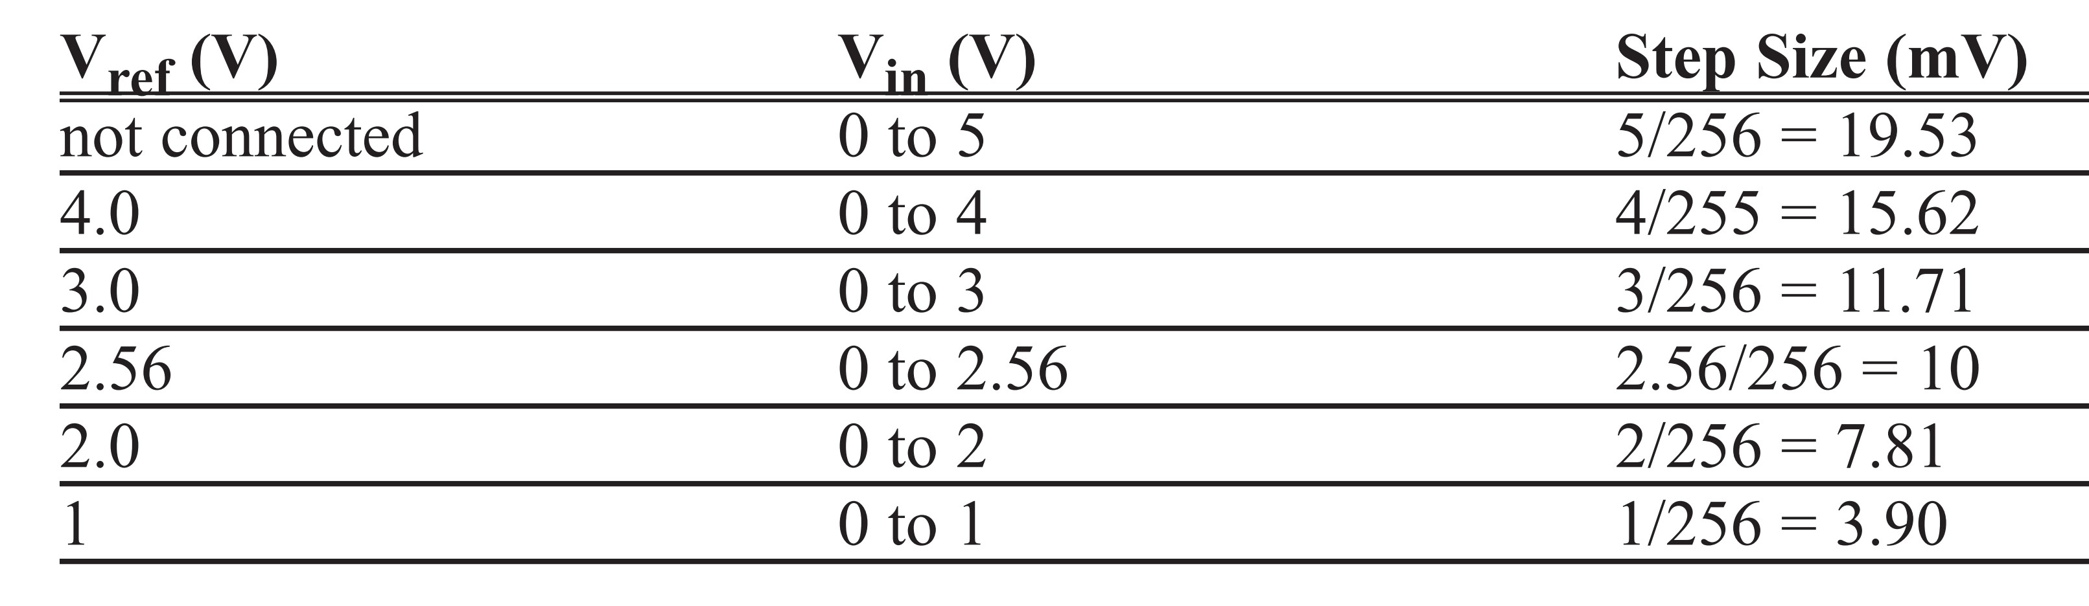
Table 13-4: V_{ref} Relation to V_{in} Range for ADC0808/0809

Slide 14
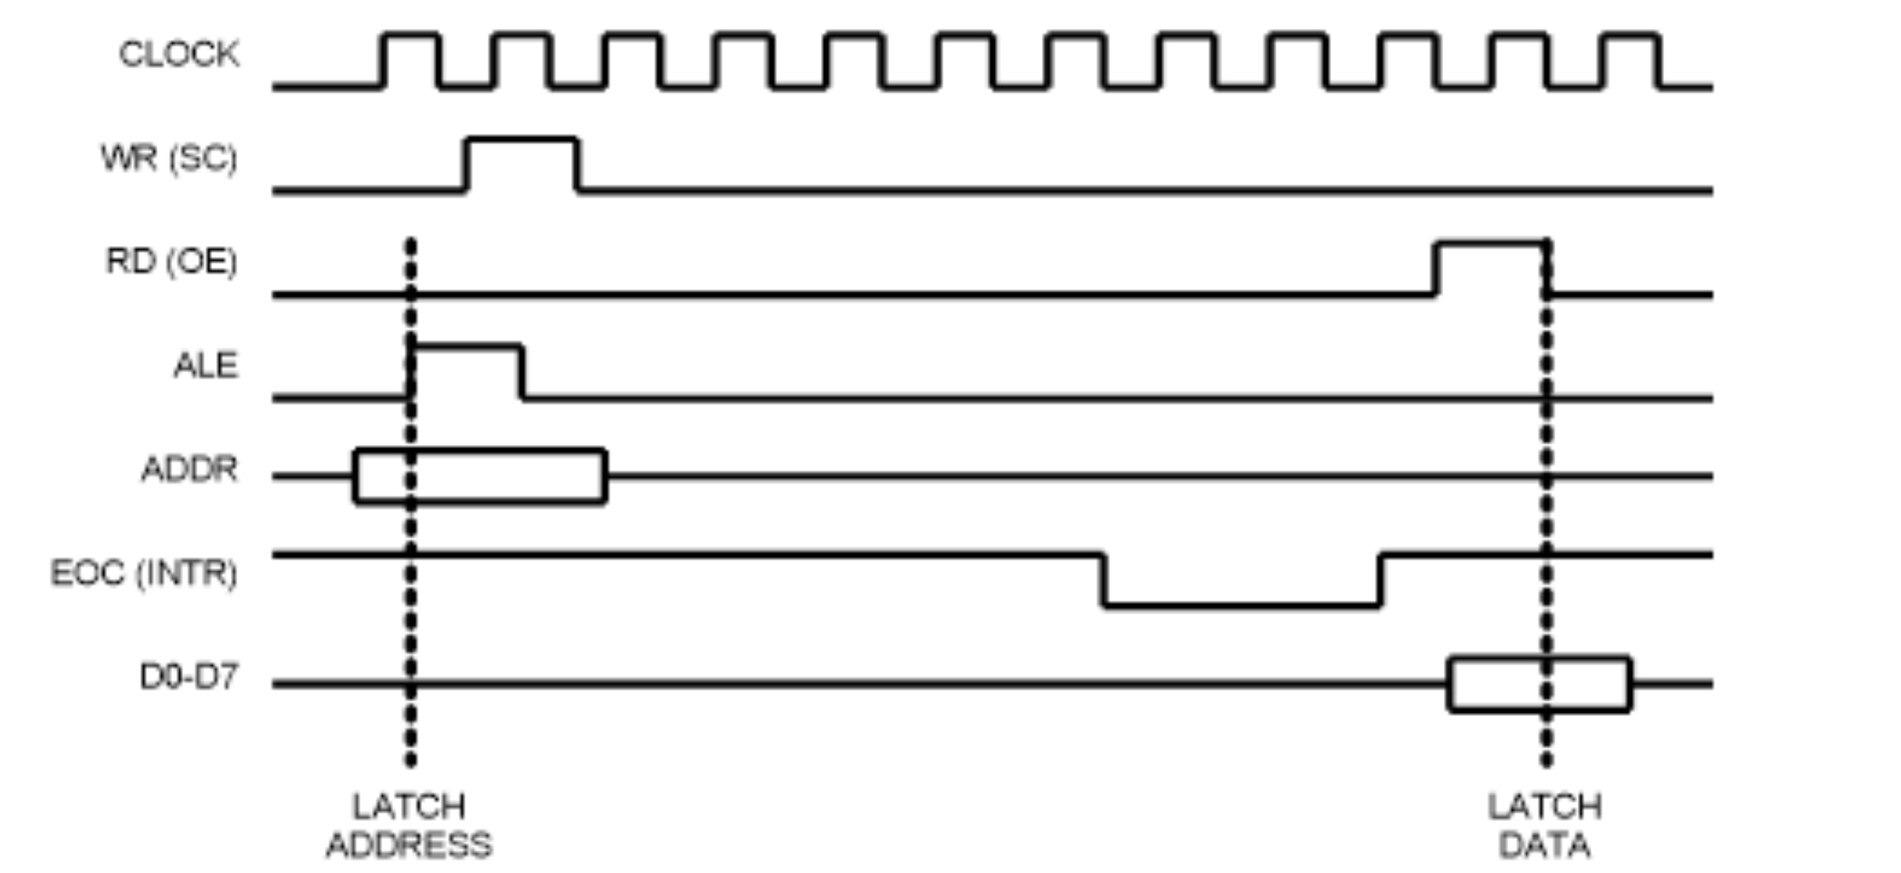
Figure 13-6. Selecting a Channel and Read Timing for ADC0809

Slide 15
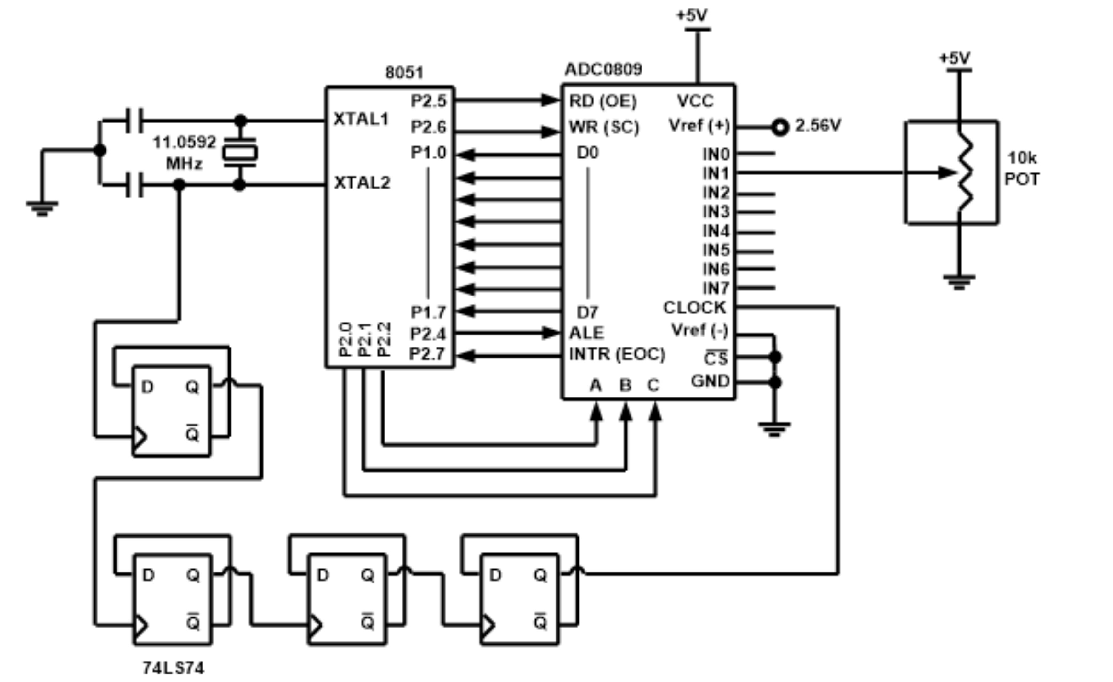
Figure 13-7. 8051 Connection to ADC0809 for Channel 1

Slide 16
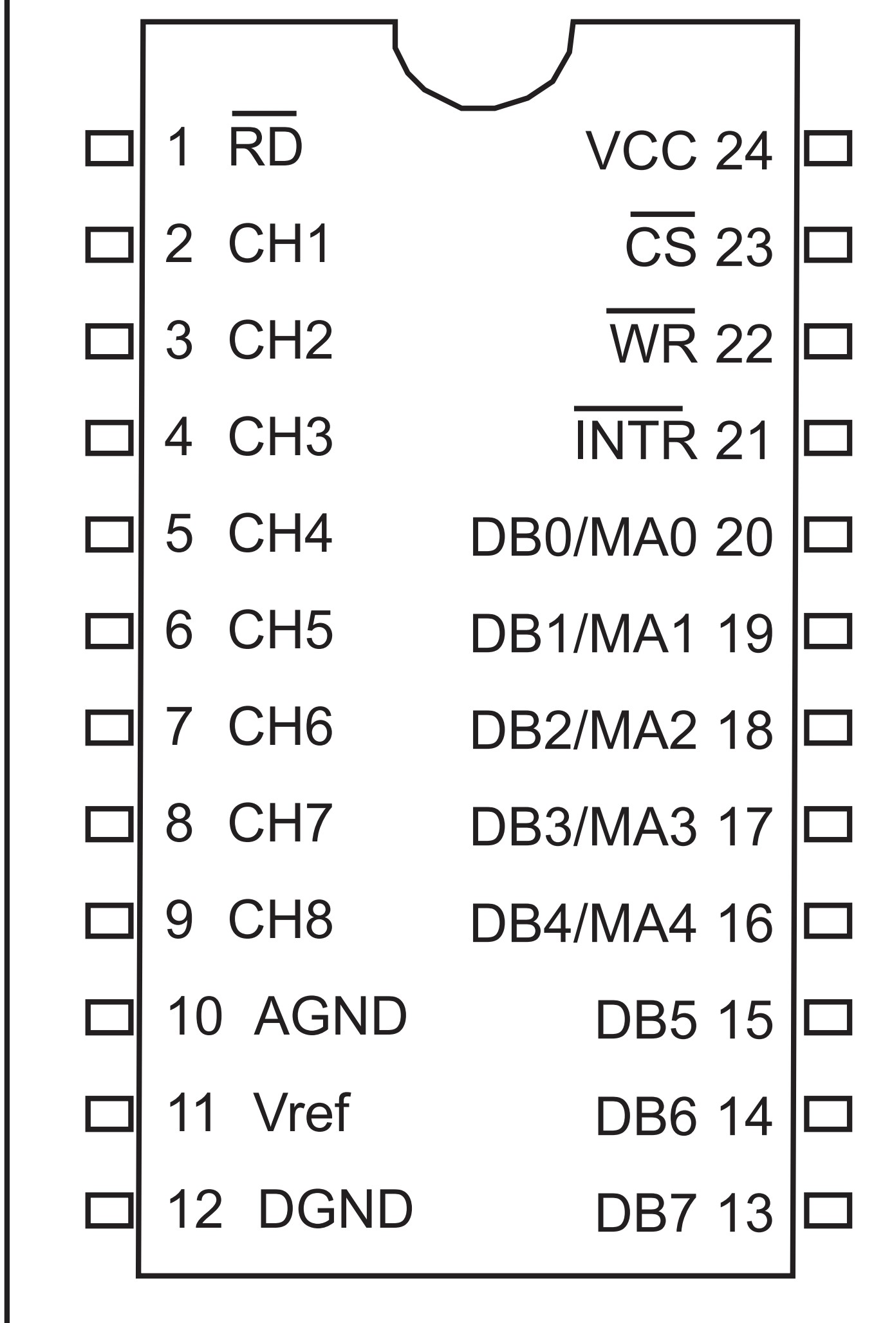
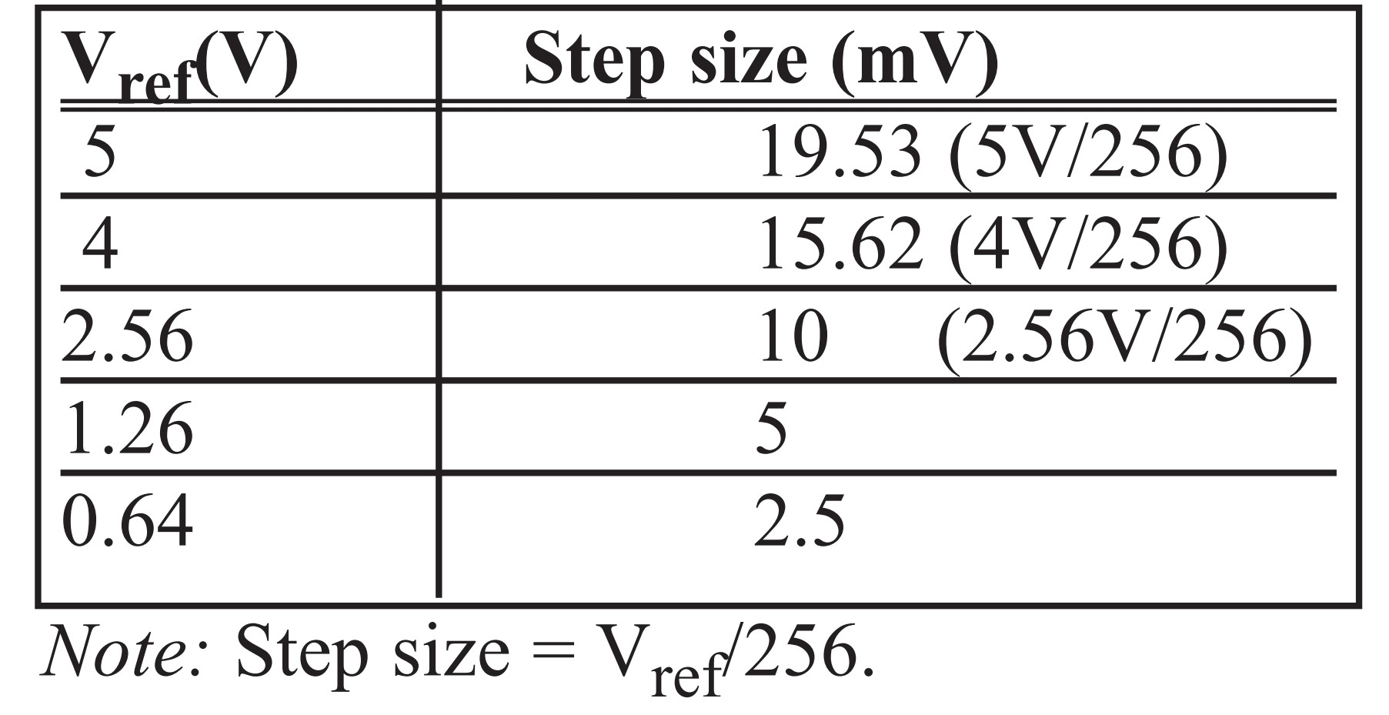
Figure 13-8. ADC0848 Chip
Table 13-5: ADC0848 V_{ref} vs. Step Size

Slide 17
Example 13-1
For a given ADC0848, we have Vref = 2.56 V. Calculate the D0 - D7 output if the analog input is: (a) 1.7 V, and (b) 2.1 V.
Solution:
Since the step size is 2.56/256 = 10 mV, we have the following.
(a) Dout = 1.7 V/10 mV = 170 in decimal, which gives us 10101011 in binary for D7 - D0.
(b) Dout = 2.1 V/10 mV = 210 in decimal, which gives us 11010010 in binary for D7 -D0. SJMP AGAIN ;keep sending A

Slide 18
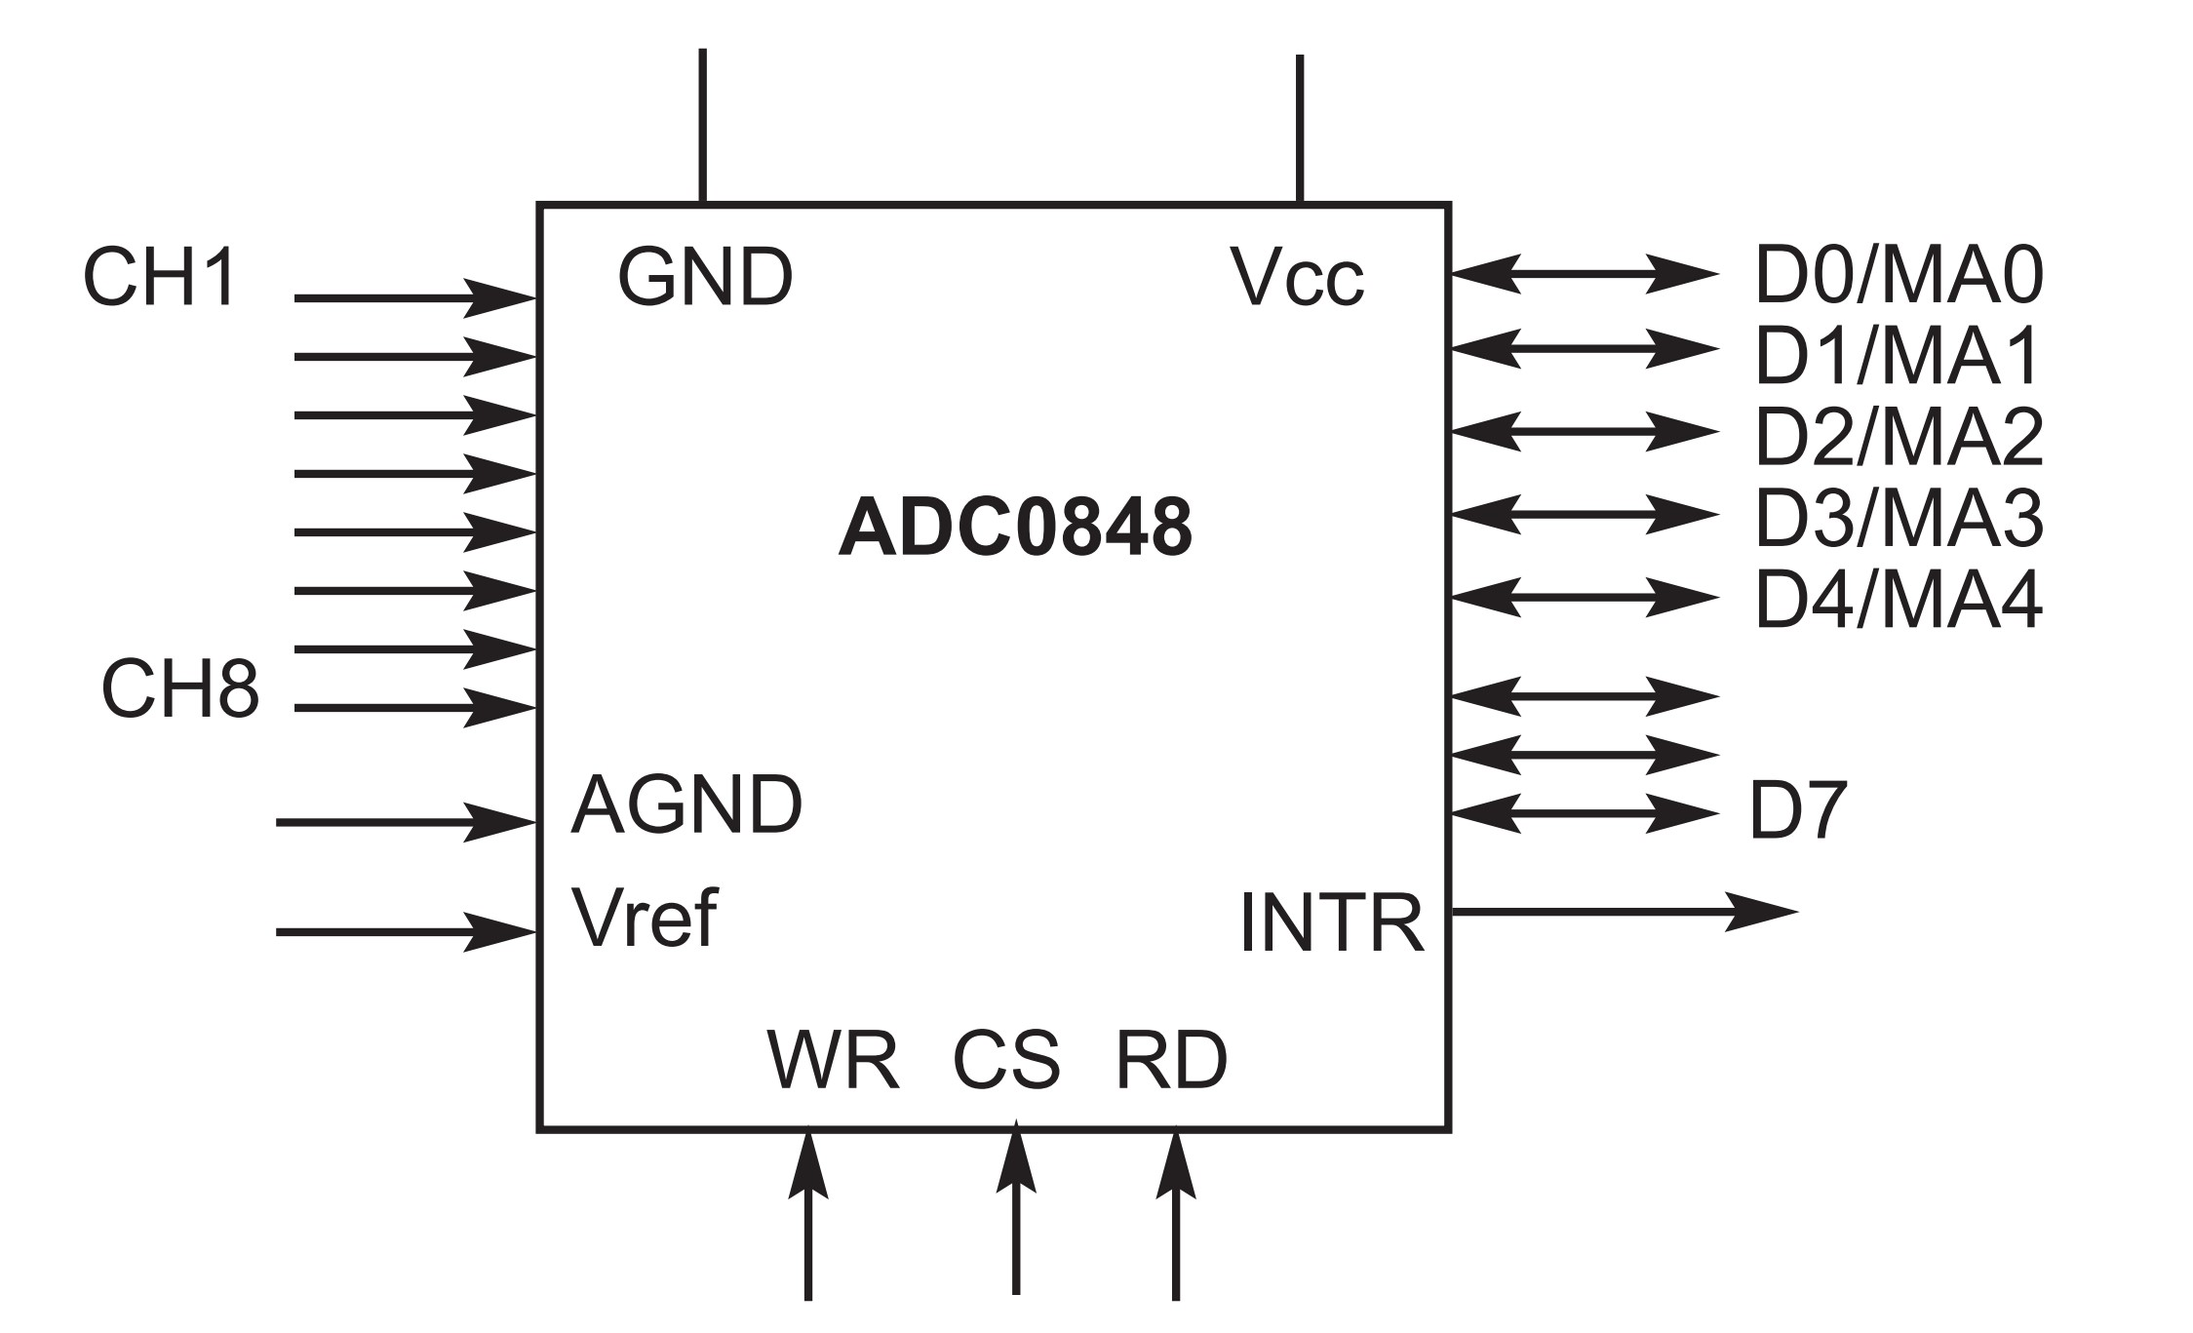
Figure 13-9. ADC0848 Block Diagram

Slide 19
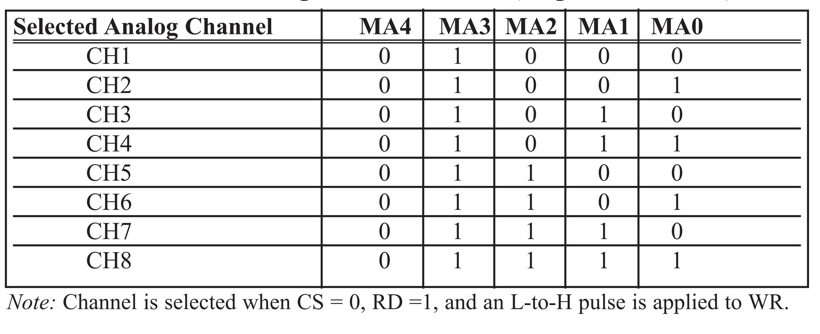
Table 13-6: ADC0848 Analog Channel Selection (Single-Ended Mode)

Slide 20
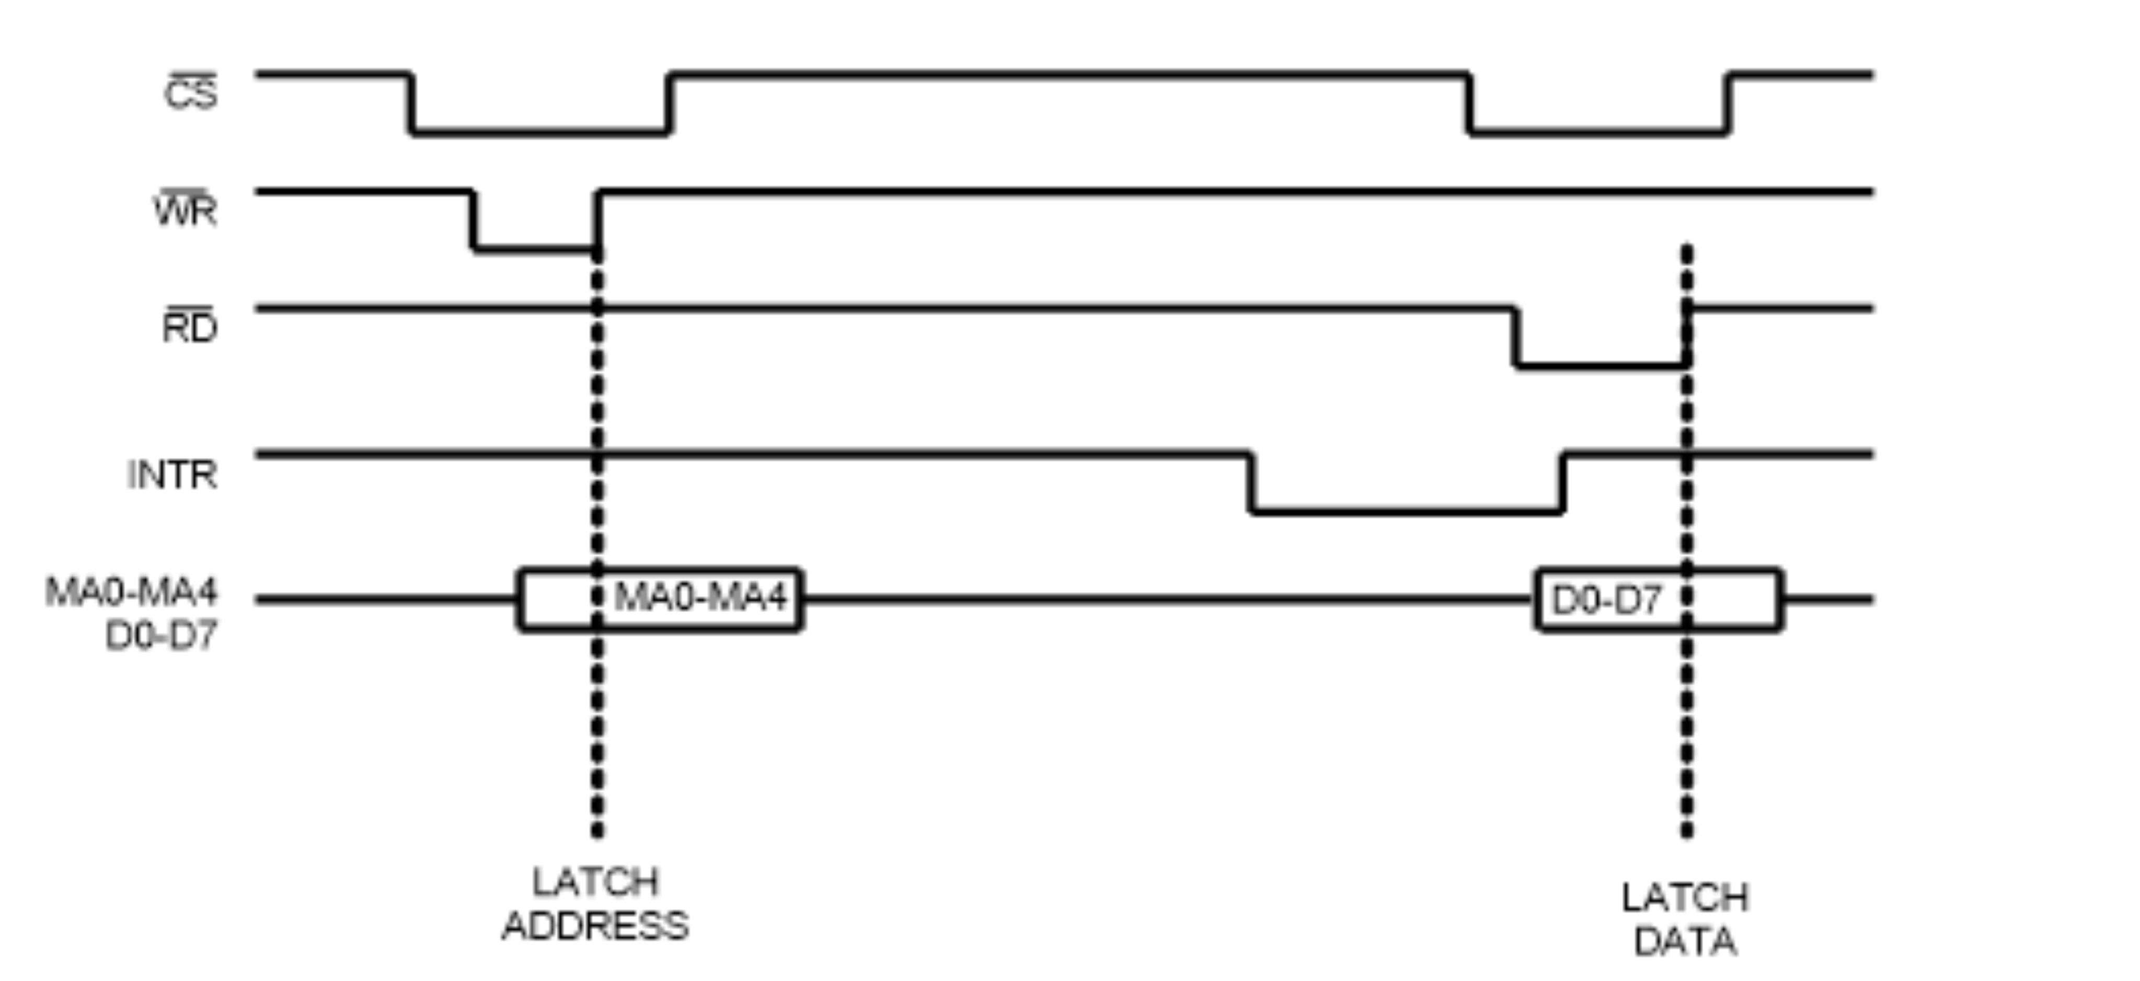
Figure 13-10. Selecting a Channel and Read Timing for the ADC0848

Slide 21
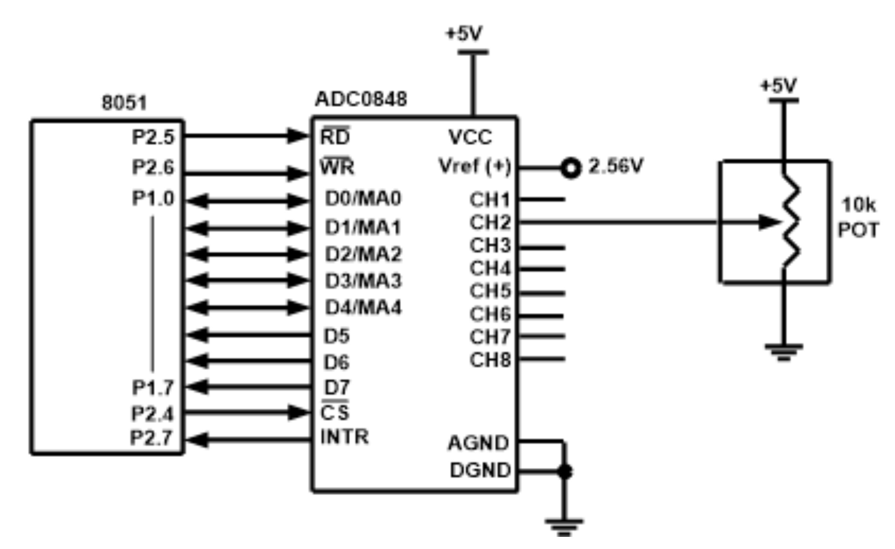
Figure 13-11. 8051 Connection to ADC0848 for Channel 2

Slide 22
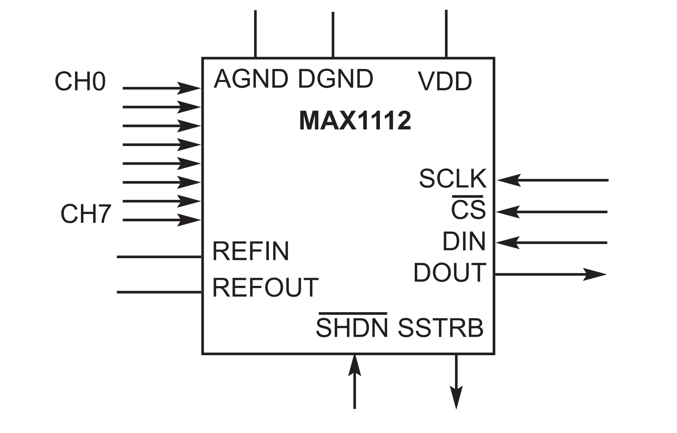
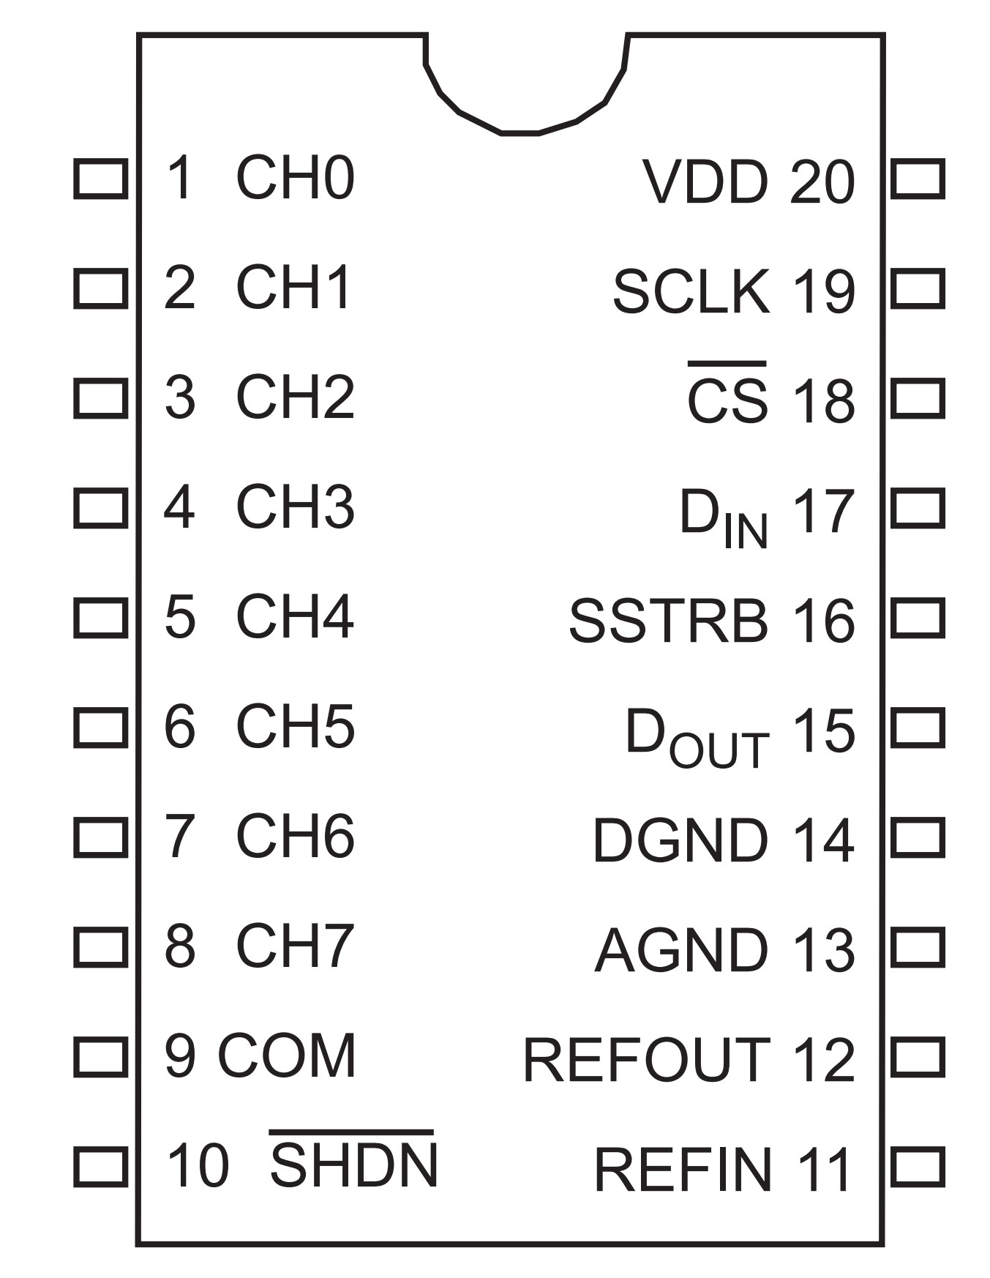
Figure 13-12. MAX1112 Chip
Figure 13-13. MAX1112 Serial ADC Block Diagram

Slide 23

Figure 13-14. MAX1112 Control Byte
Start The MSB (D7) must be high to define the beginning of the control byte.
It must be sent in first.
SEL2 SEL1 SEL0 CHANNEL SELECTION (SINGLE-ENDED MODE)
0 0 0 CHAN0
0 0 1 CHAN1
0 1 0 CHAN2
0 1 1 CHAN3
1 0 0 CHAN4
1 0 1 CHAN5
1 1 0 CHAN6
1 1 1 CHAN7
UNI/BIP 1 = unipolar: Digital data output is binary 00 - FFH.
0 = bipolar: Digital data output is in 2’s complement.
SGL/DIF 1 = single-ended: 8 channels of single-ended with COM as reference
0 = differential: Two channels (eg., CH0 - CH1) are differential.
PD1 1 = fully operational
0 = power-down: Power down to save power using software.
PD0 1 = external clock mode: The conversion speed is dictated by SCLK.
0 = internal clock mode: The conversion speed is dictated internally,
and the SSTRB pin goes high to indicate end-of-conversion (EOC).

Slide 24
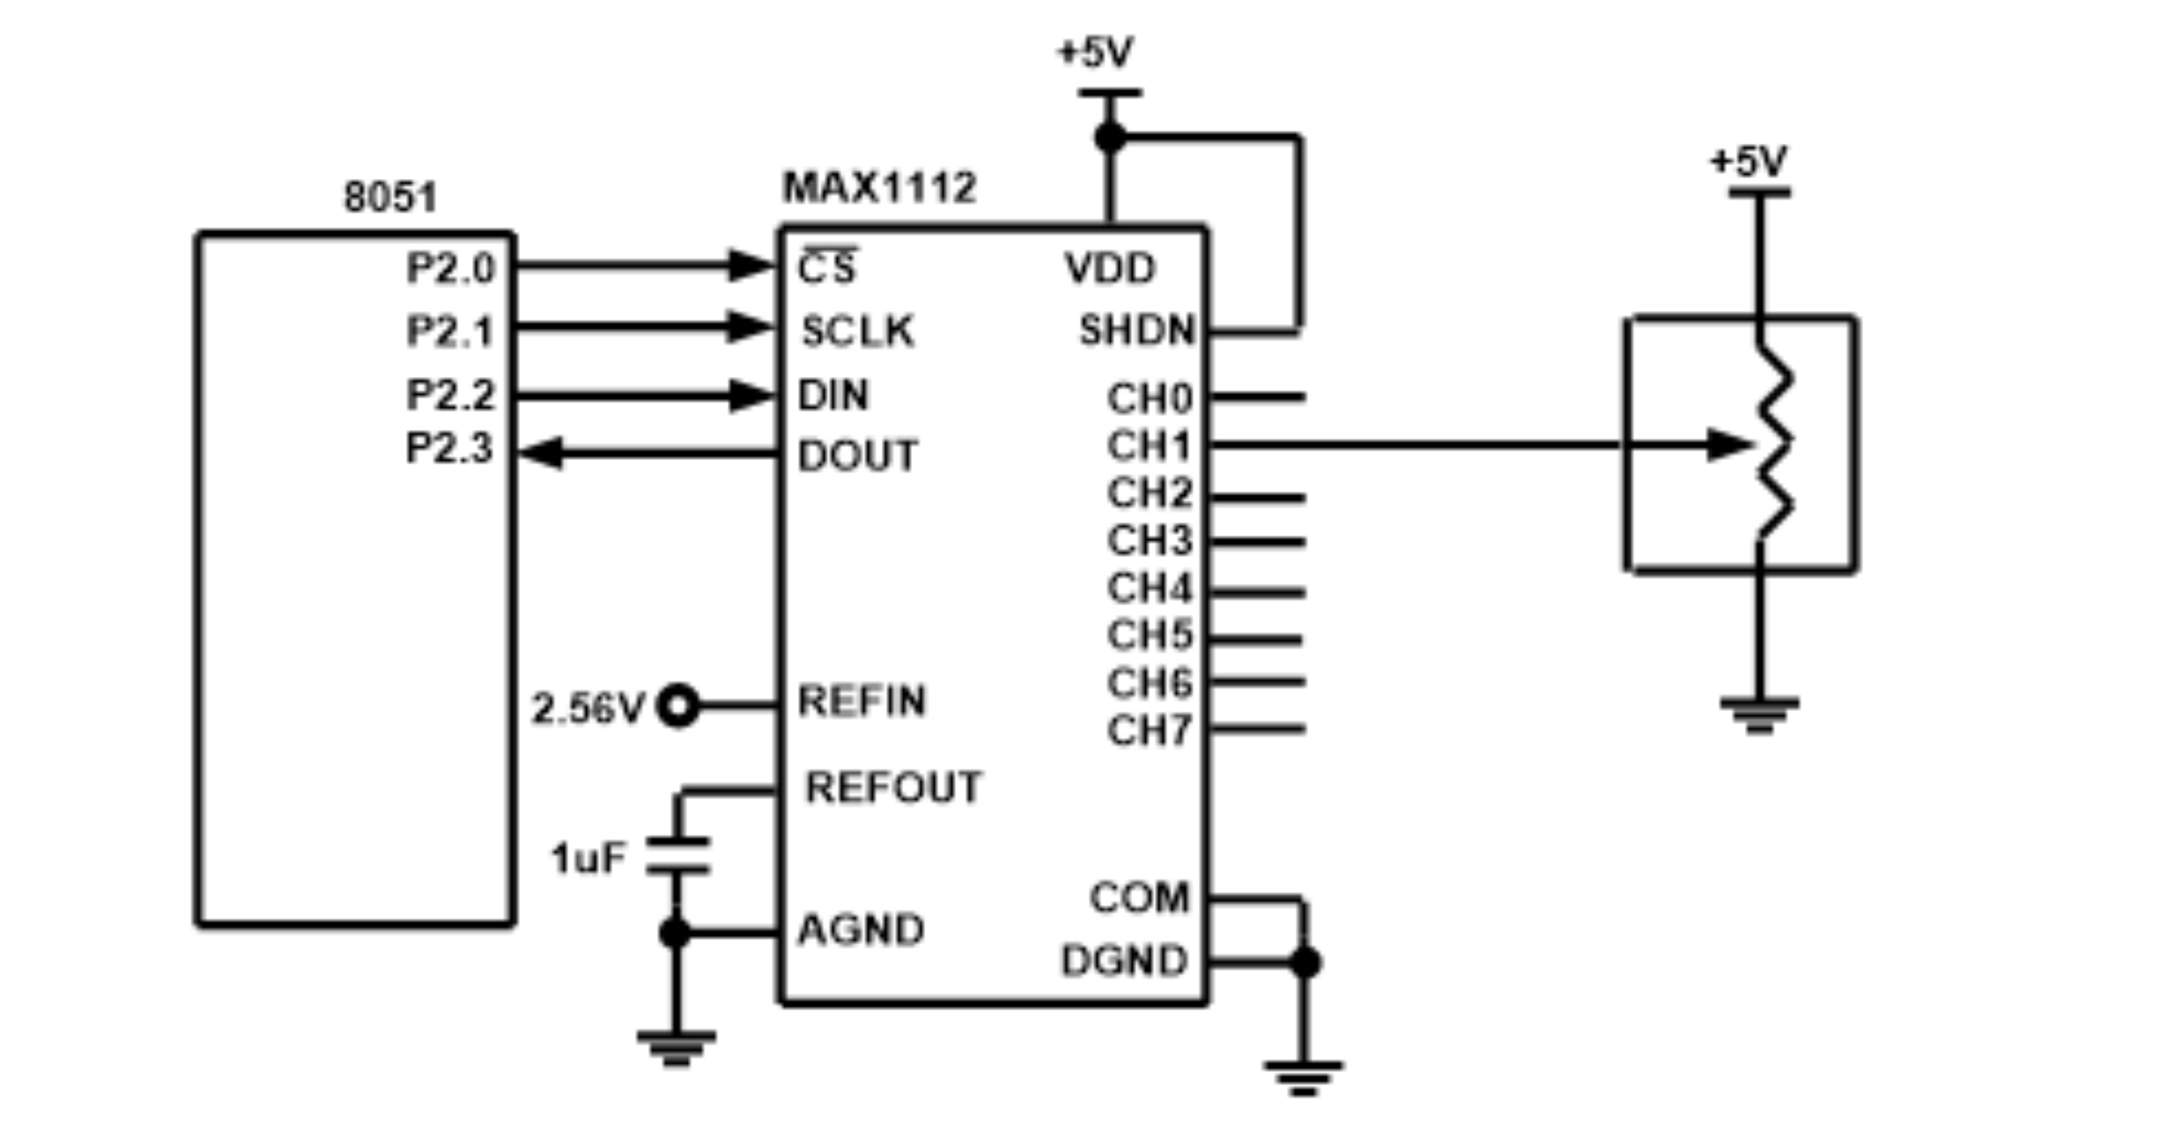
Figure 13-15. 8051 Connection to MAX1112 for 2nd Channel

Slide 25
Example 13-2
Find the MAX1112 control byte for
CH0,
and (b) CH3.
Assume single-ended, unipolar, internal clock, and fully operational modes.
Solution:
From Figure 13-14, we have the following:
10001110 (8E in hex)
(b) 10111110 (BE in hex)

Slide 26
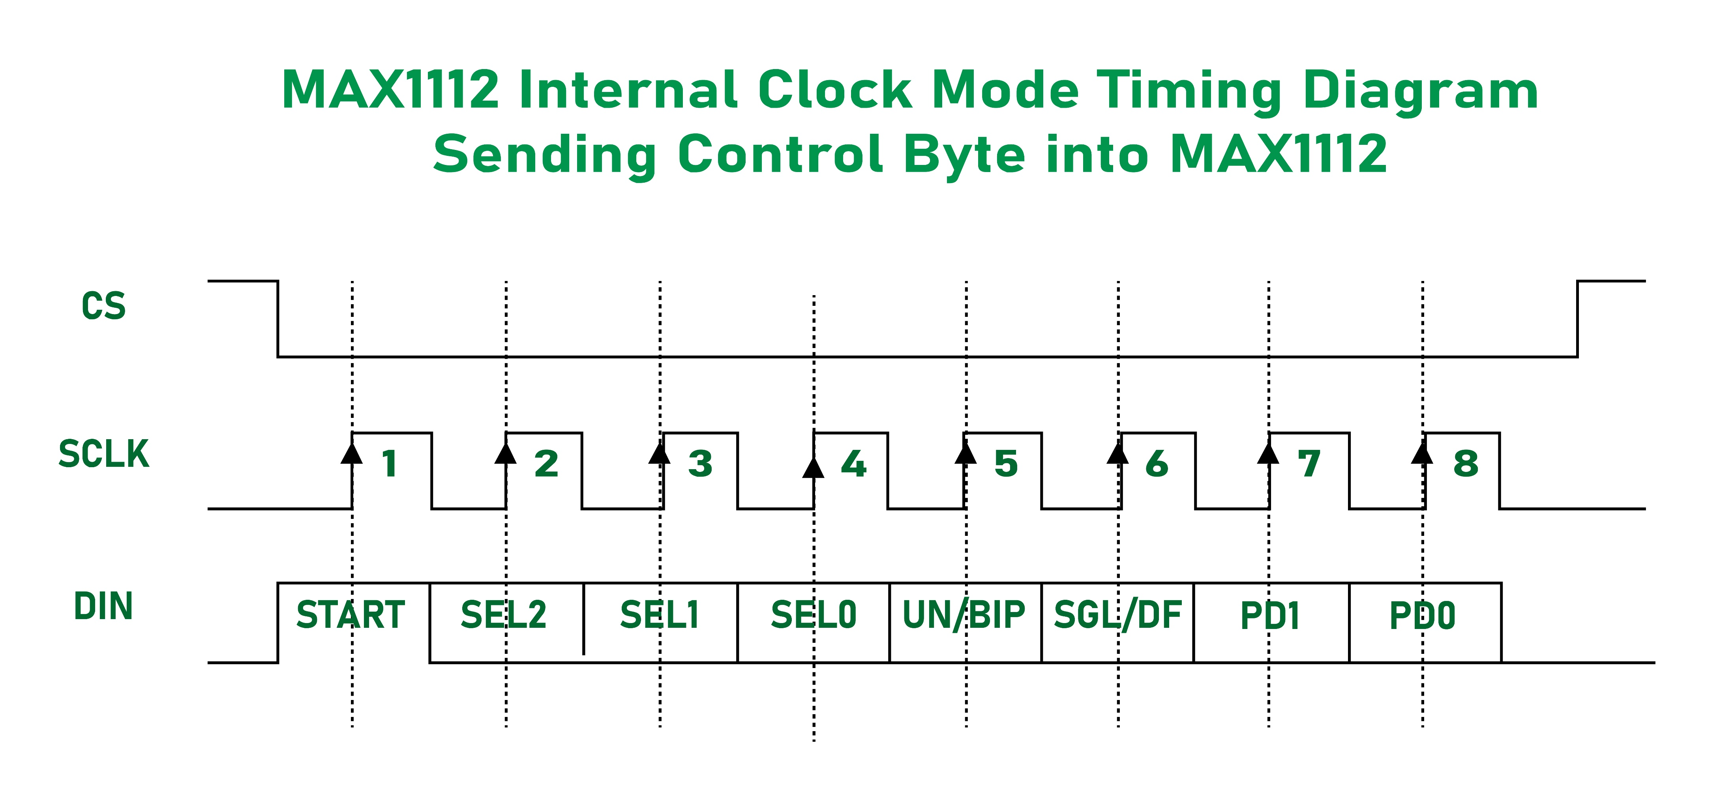
Figure 13-16. Sending Control Byte into MAX1112

Slide 27
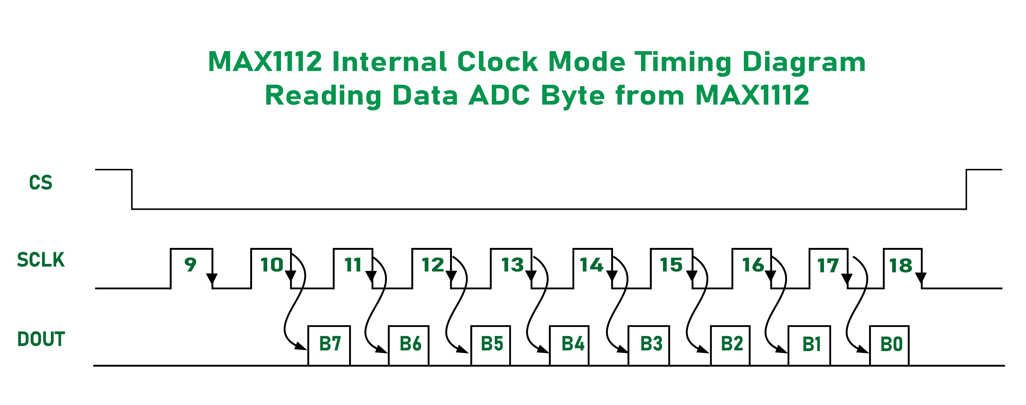
Figure 13-17. Reading ADC Data Byte from MAX1112

Slide 28
Example 13-3
Assuming that R = 5K and I_{ref} = 2 mA, calculate V_{out} for the following binary inputs:
(a) 10011001 binary (99H) (b) 11001000 (C8H)
Solution:
(a) I_{out} = 2 mA (153/256) = 1.195 mA and V_{out} = 1.195 mA x 5K = 5.975 V
(b) I_{out} = 2 mA (200/256) = 1.562 mA and V_{out} = 1.562 mA x 5K = 7.8125 V

Slide 29
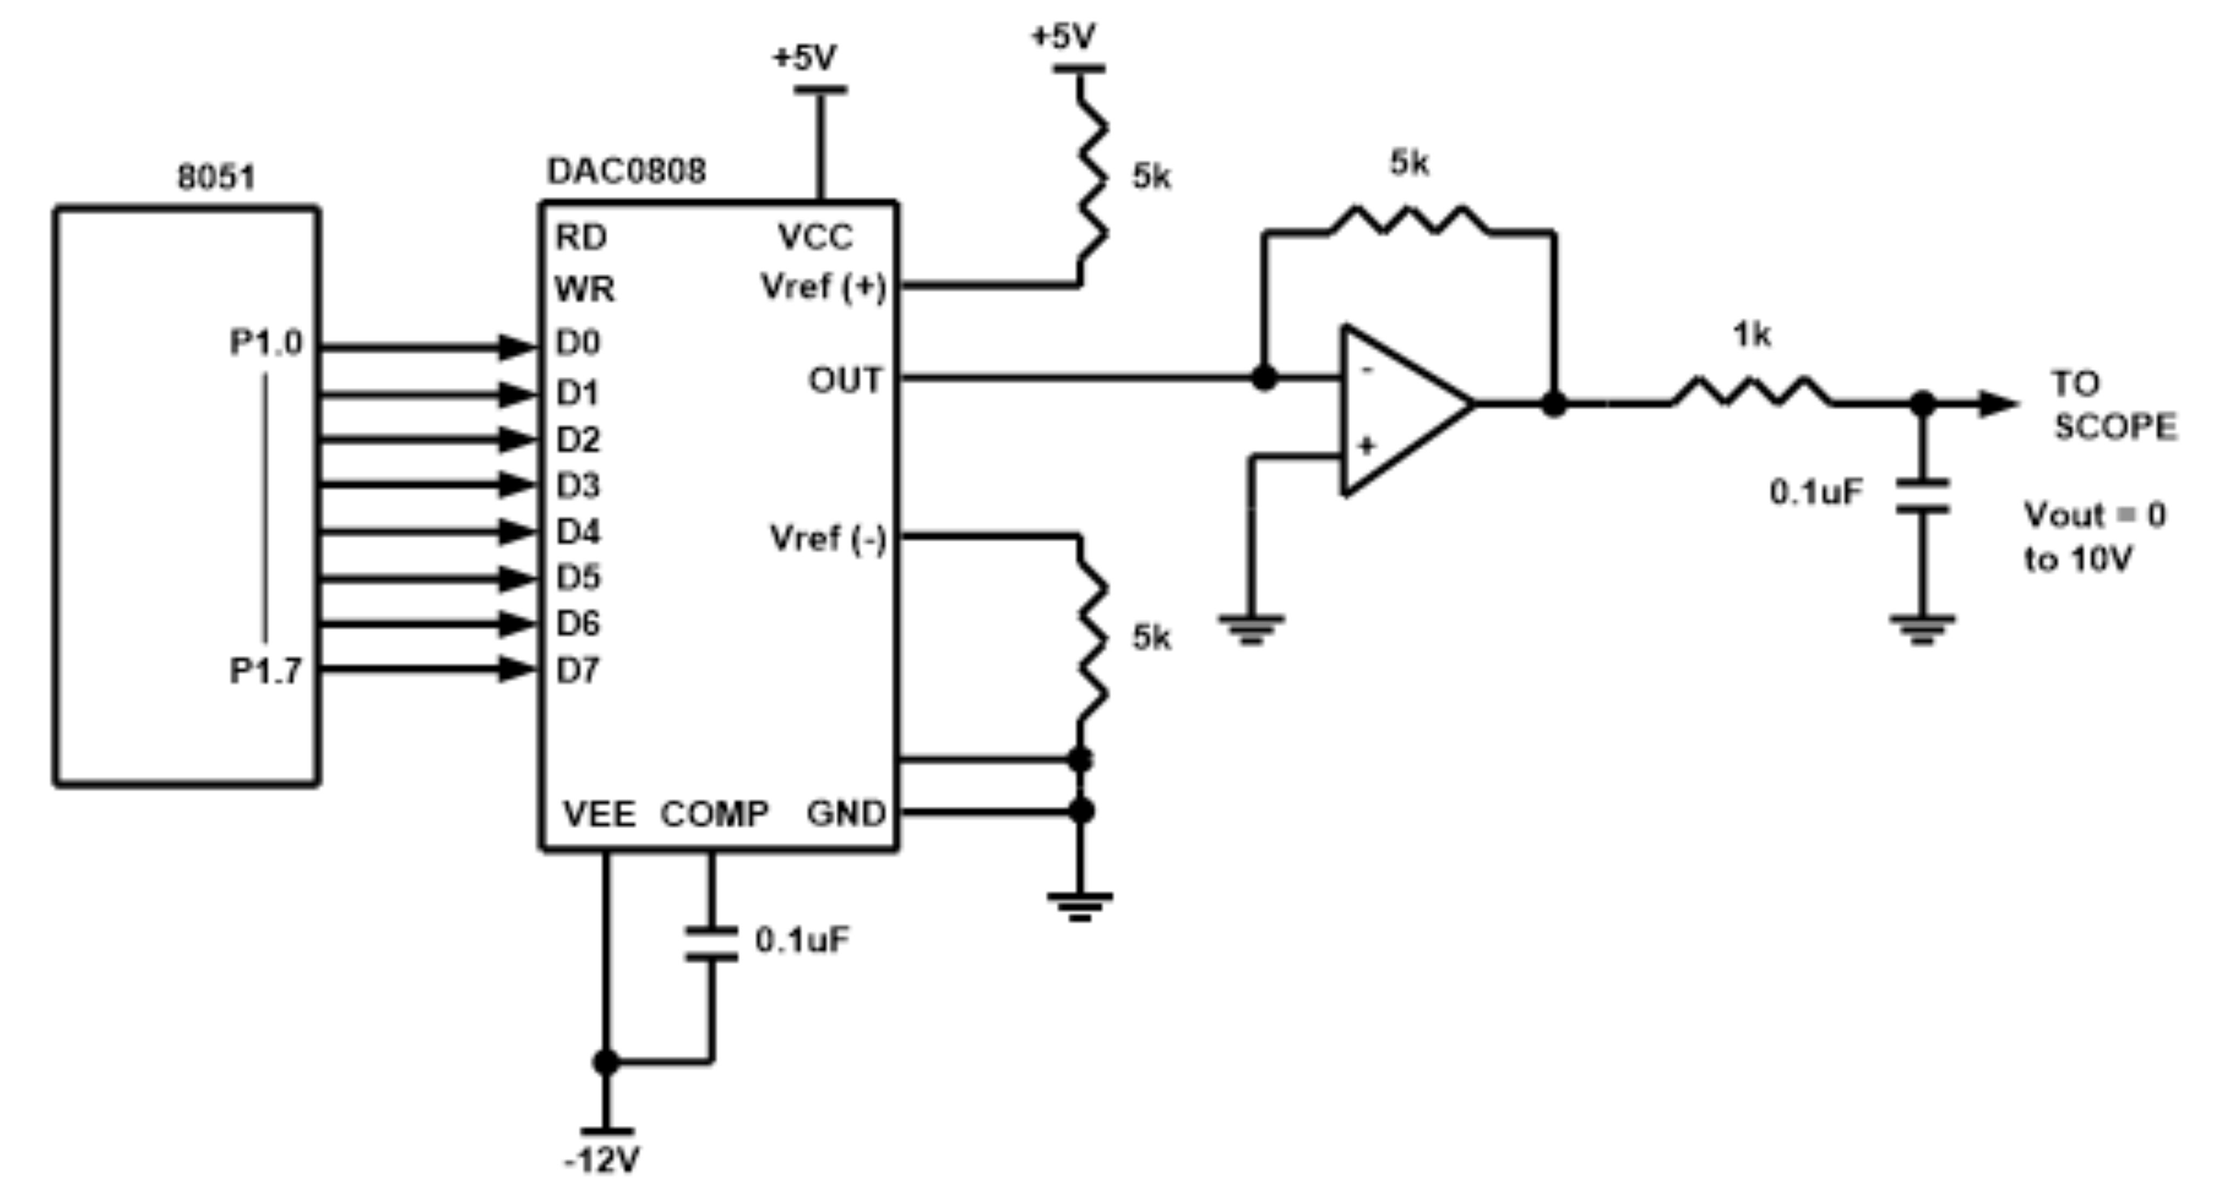
Figure 13-18. 8051 Connection to DAC808

Slide 30
Example 13-4
In order to generate a stair-step ramp, set up the circuit in Figure 13-18 and connect the output to an oscilloscope. Then write a program to send data to the DAC to generate a stair-step ramp.
Solution:
CLR A
AGAIN: MOV P1,A ;send data to DAC
INC A ;count from 0 to FFH
ACALL DELAY ;let DAC recover
SJMP AGAIN

Slide 31
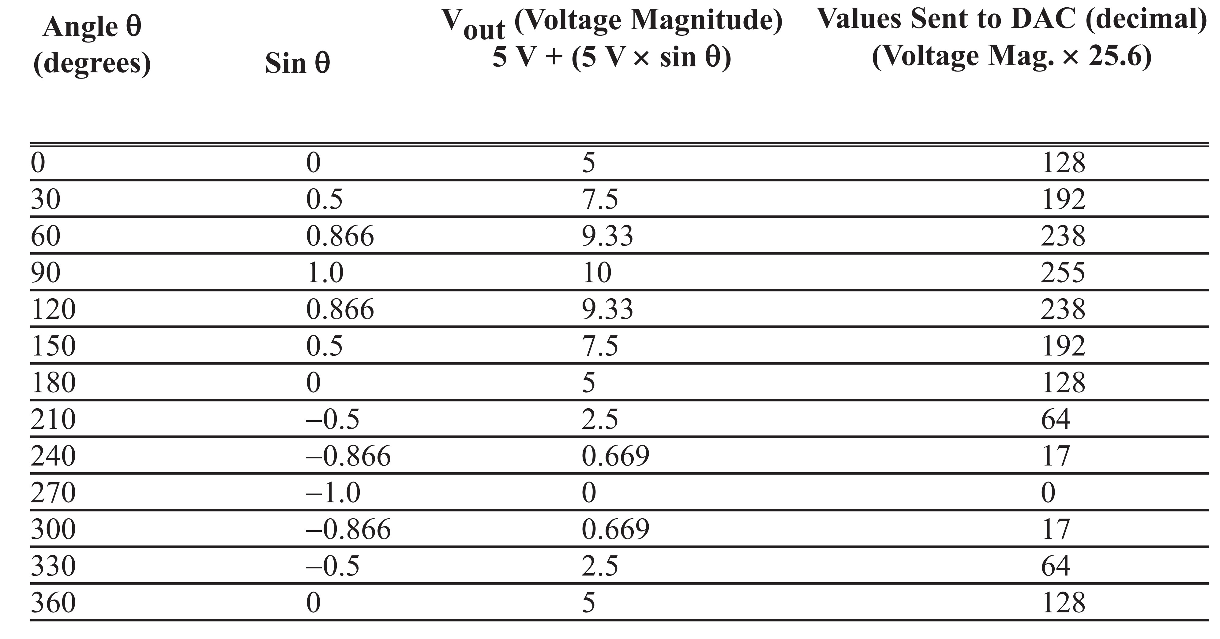
Table 13-7: Angle vs. Voltage Magnitude for Sine Wave

Slide 32
Example 13-5
Verify the values given for the following angles: (a) 30° (b) 60°.
Solution:
(a) V_{out} = 5 V + (5 V x sin q) = 5 V + 5 x sin 30° = 5 V + 5 x 0.5 = 7.5 V
DAC input values = 7.5 V x 25.6 = 192 (decimal)
(b) V_{out} = 5 V + (5 V x sin q) = 5 V + 5 x sin 60° = 5 V + 5 x 0.866 = 9.33 V
DAC input values = 9.33 V x 25.6 = 238 (decimal)

Slide 33
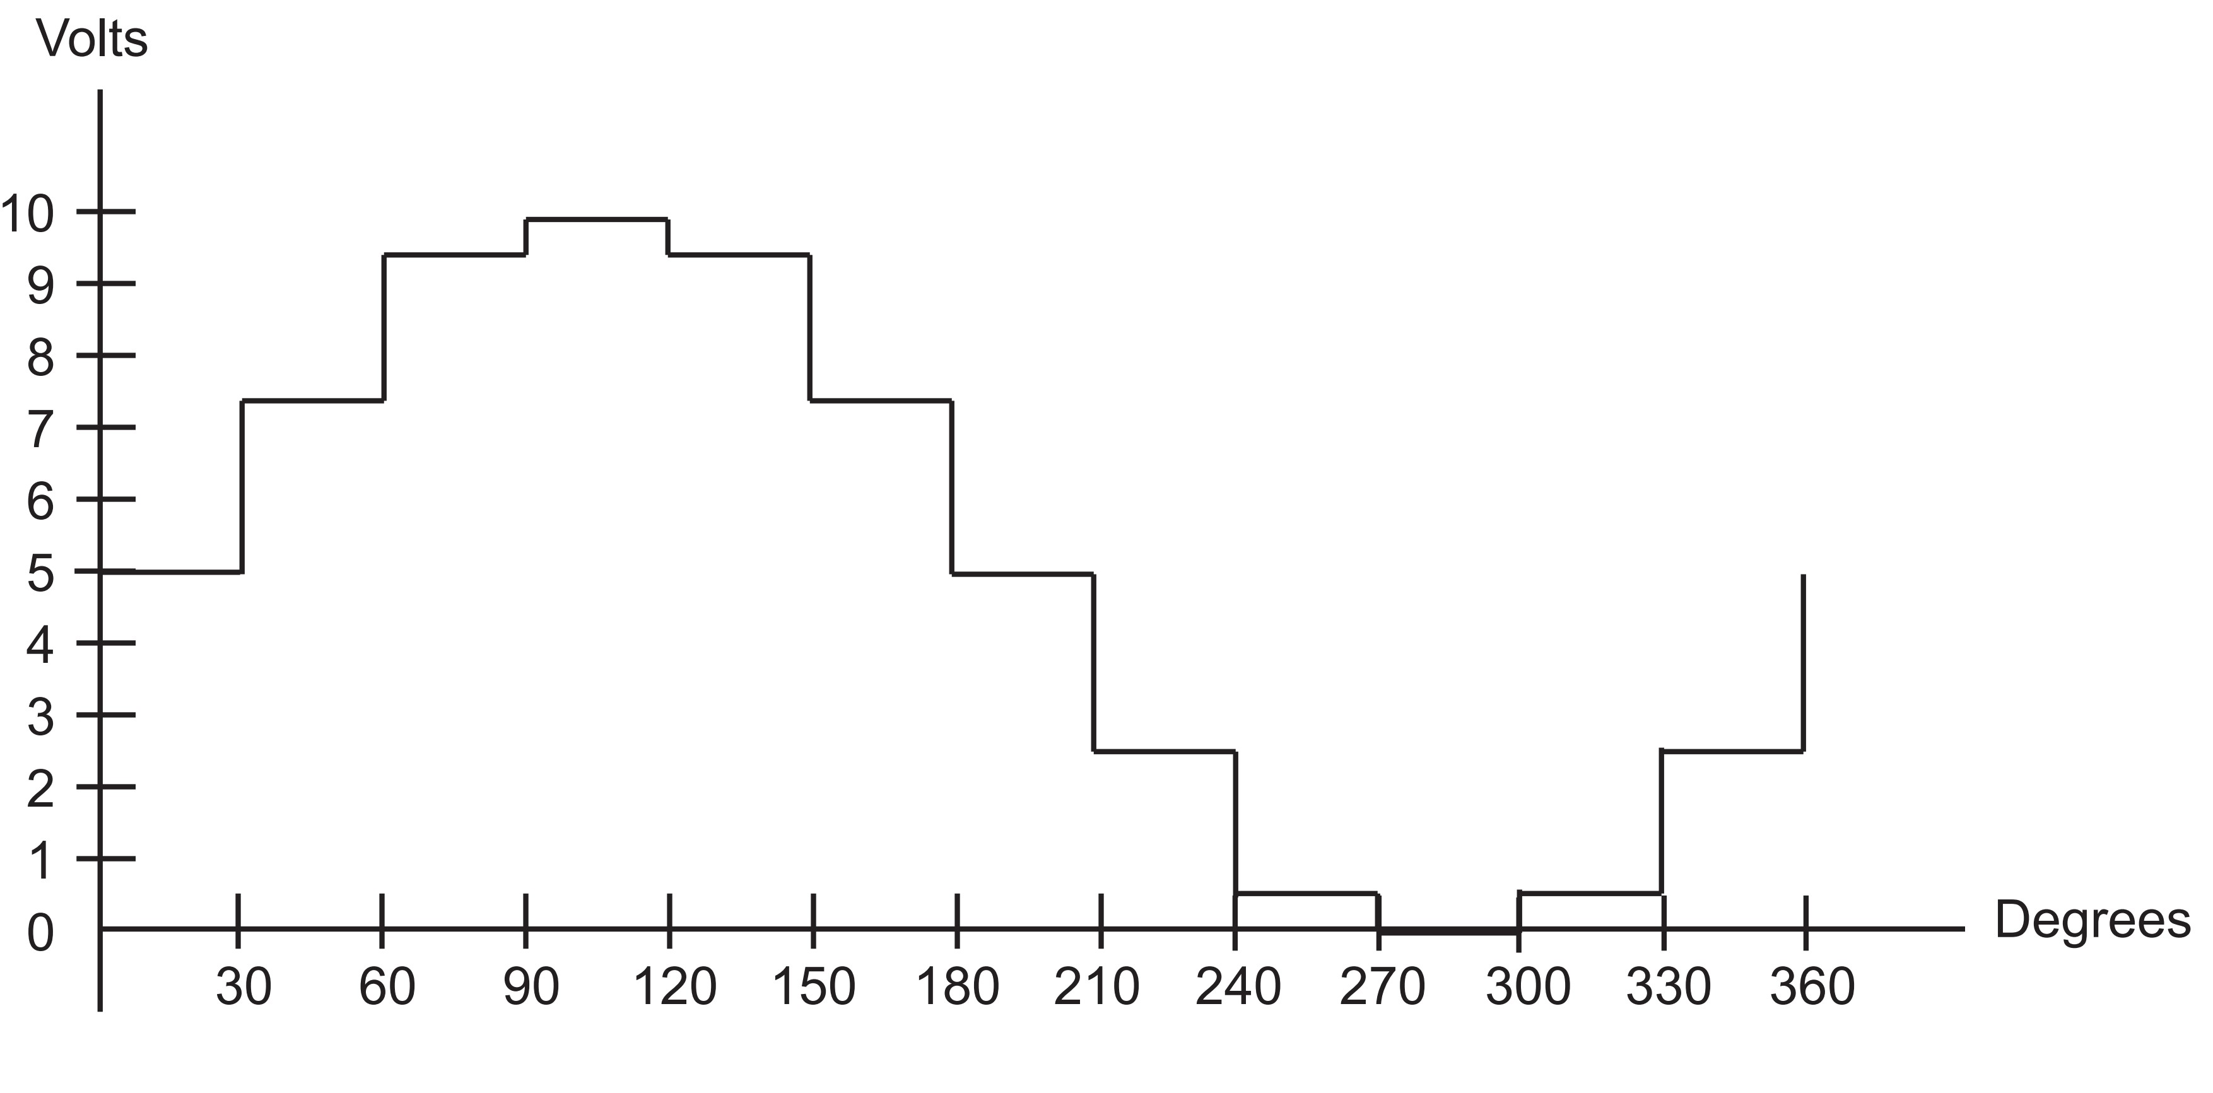
Figure 13-19. Angle vs. Voltage Magnitude for Sine Wave

Slide 34
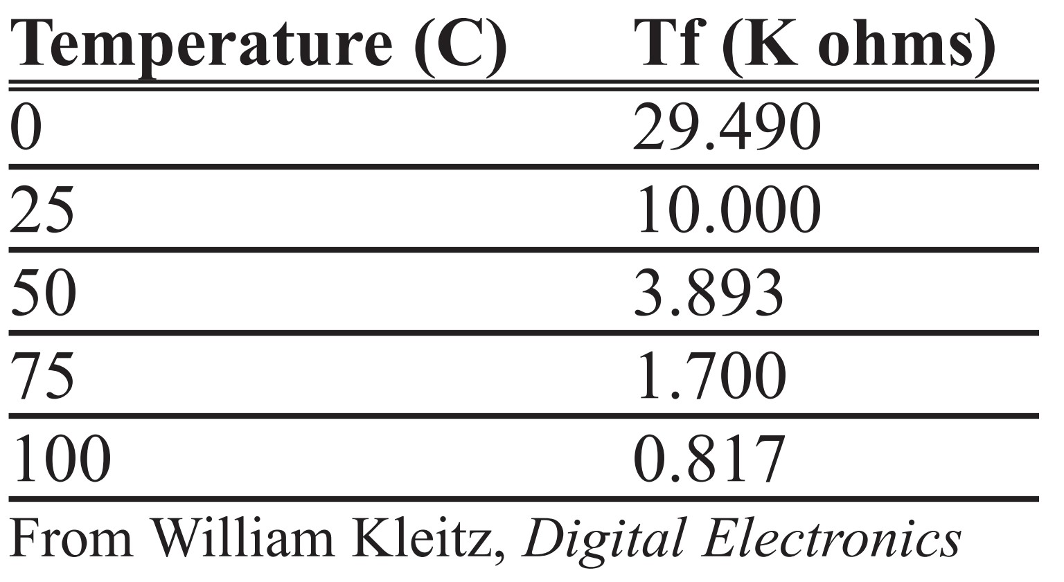
Table 13-8: Thermistor Resistance vs. Temperature

Slide 35
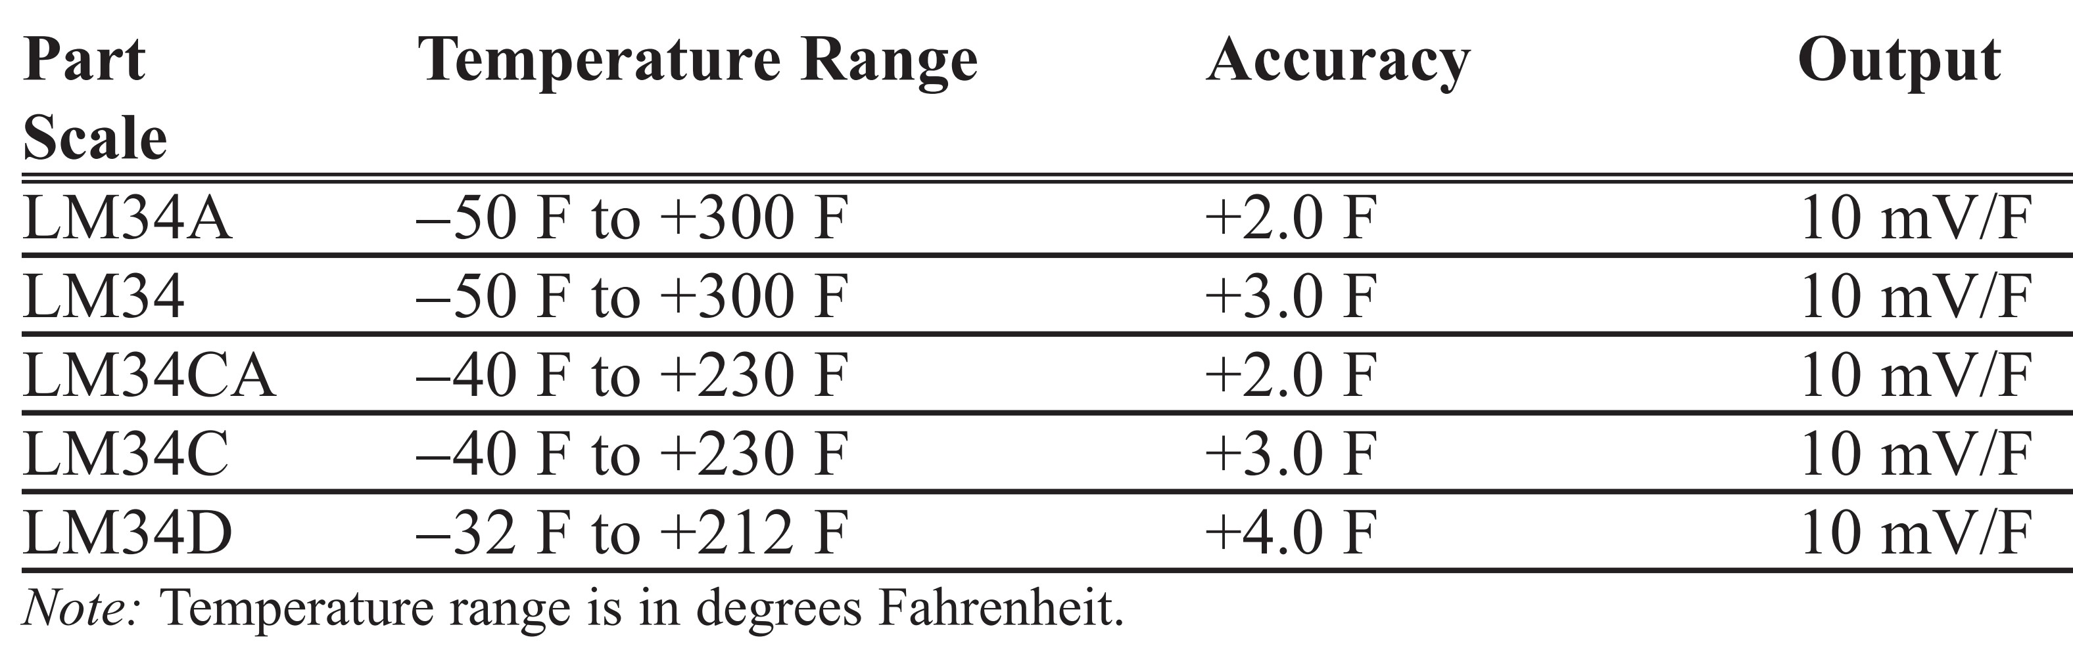
Table 13-9: LM34 Temperature Sensor Series Selection Guide

Slide 36
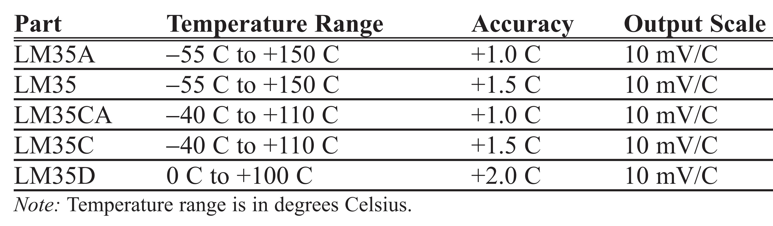
Table 13-10: LM35 Temperature Sensor Series Selection Guide

Slide 37
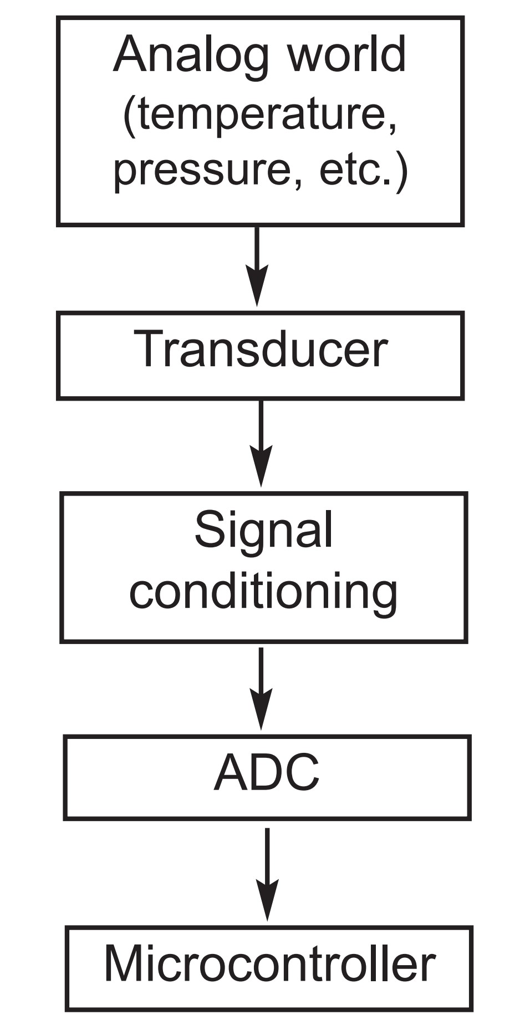
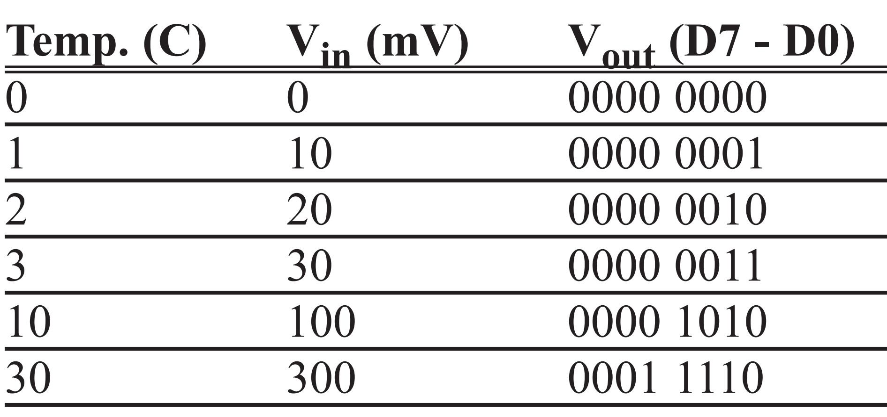
Figure 13-20. Getting Data From the Analog World
Table 13-11: Temperature vs. Vout for ADC0848

Slide 38
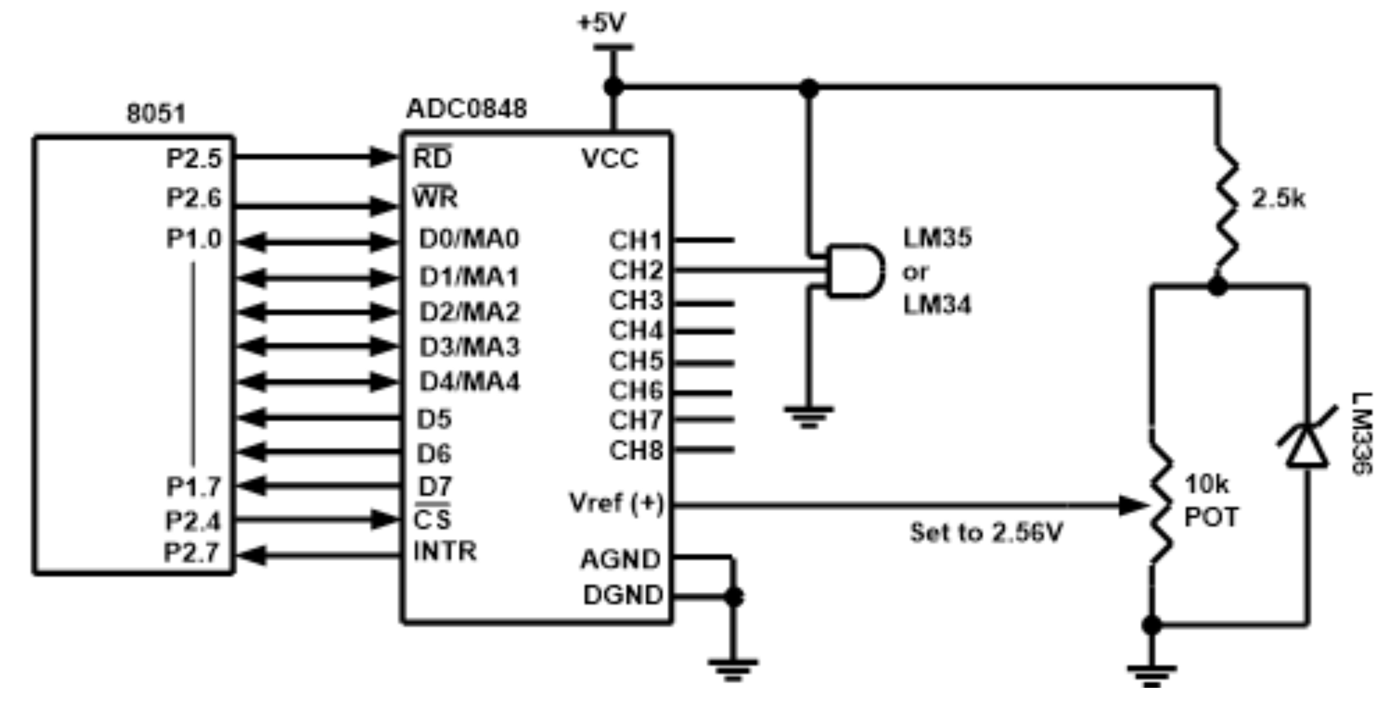
Figure 13-21. 8051 Connection to ADC0848 and Temperature Sensor

